Slide 1

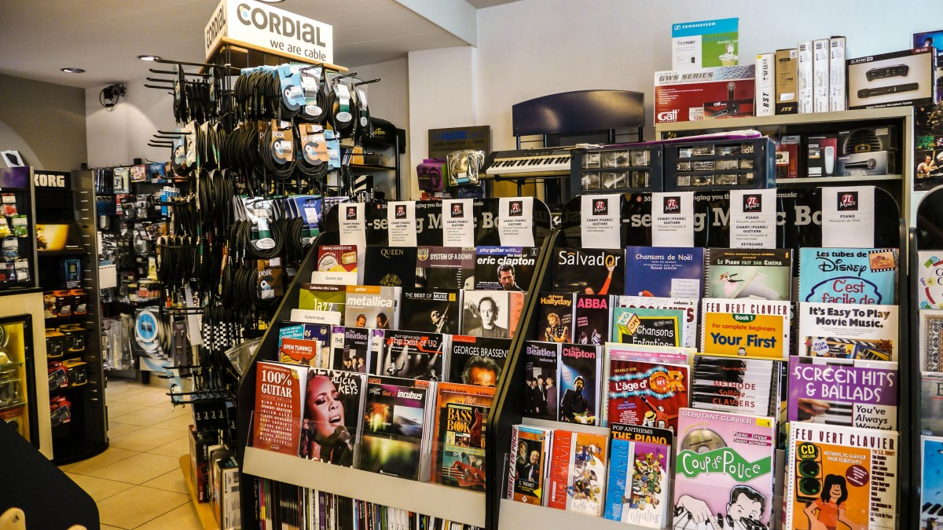

Sample SuperStore data overview and insights and analysis
data-driven insights for business growth

Slide 2


CONTENT
INTRODUCTION
SALES INSIGHTS
PROFIT ANALYSIS
CUSTOMER INSIGHTS
REGIONAL PERFOMANCE
FINANCIAL ANALYSIS

Slide 3




INTRODUCTION TO SUPERSTORE DATA

Slide 4

INTRODUCTION TO SUPERSTORE DATA
THE SAMPLE SUPERSTORE DATSET IS A POPULAR DATASET USED IN DATA ANALYSIS AND VISUALIZATION IT REPRESENT A FICTIONAL RETAIL STORE’S SALES RECORDS AND PROCIDE VALUEABLE INSIGHTS INTO BUSSINESS PERFORMANCE

Slide 5
DATASET OVERVIEW
ORDERS DATA : INFORMATION ABOUT INDIVIDUAL TRANSACTIONS
SALES DATA : REVENUE GENERATED FROM ORDERS
PROFIT DATA : NET PROFITAFTER DISCOUNTS AND COSTS
CUSTOMER DATA : SEGMENTATION BY CUSTOMER TYPE AND REGION
GROGRAPHIC DATA : SALES AND PROFIT ACROSS REGIONS AND STATES

Slide 6
objective OF ANALYSIS
IDENTIFY
IDENTIFY SALES TRENDS OVER TIME
EVALUATE
EVALUATE PROFITABILITY ACROSS CATEGORIES AND REGIONS
UNDERSTAND
UNDERSTAND CUSTOMER SEGMENTS AND BUYING PATTERN
DISCOVER
DISCOVER OPPORTUNITIES FOR BUSINESS GROWTH

Slide 7
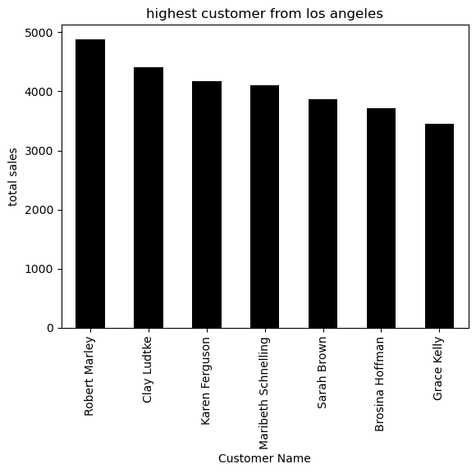
Sales performance analysis

Slide 8
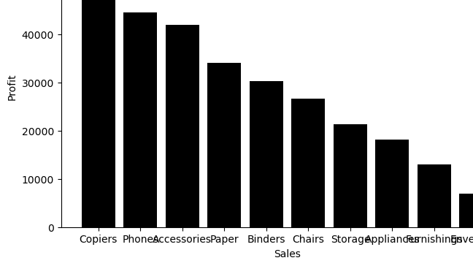
Sales and profit analyize

Slide 9
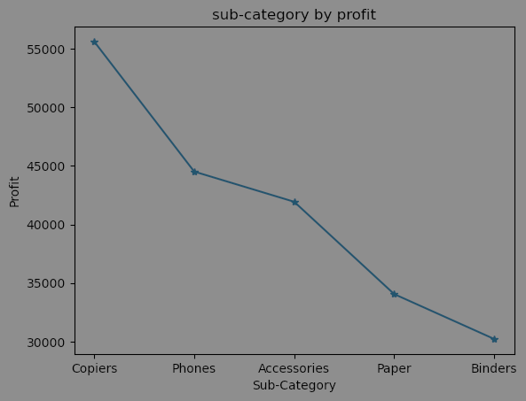
SUB-CATEGORY SALES ANALYSIS

Slide 10
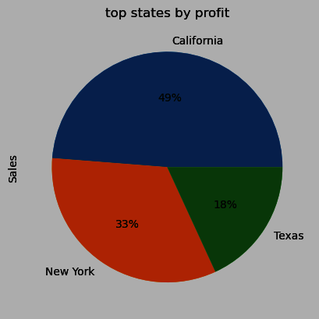
TOP STATE BY PROFIT

Slide 11
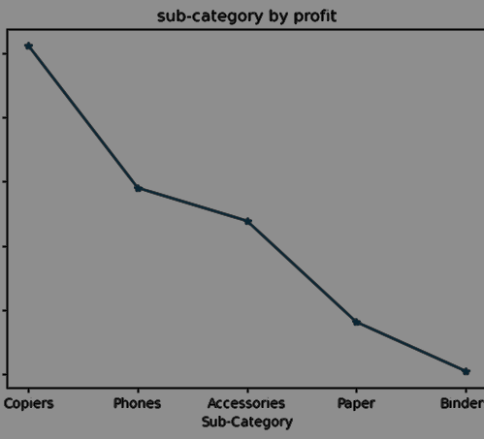
SUB-CATEGORY BY PROFIT

Slide 12
KEY MATRICS AND DIMENSION
TOTAL SALES, TOTAL PROFIT , NO. OF ORDERS , QUANTITY ,
DISCOUNTS , AVARAGE ORDER VALUE , CATEGORY-WISE SALE/PROFIT
TIME-BASED MATRICS ETC

Slide 13
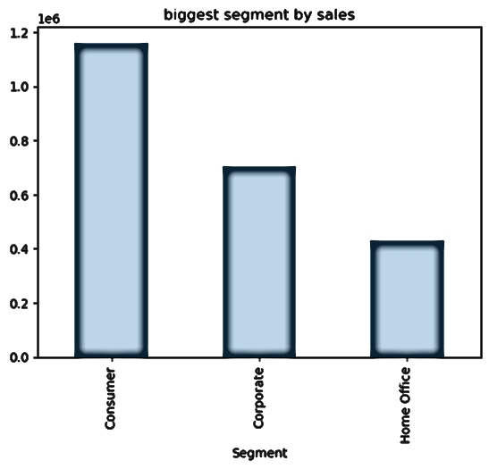
SEGMENT SALES ANALYZE

Slide 14
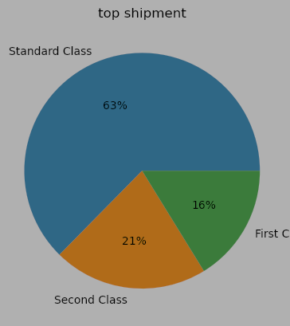
TOP SHIPMENT MODES

Slide 15

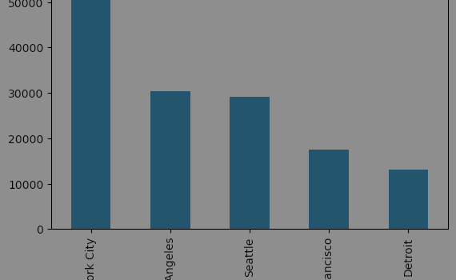
MOST PROFITABLE CITIES

Slide 16
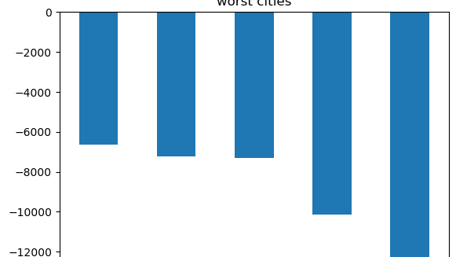
WORST CITIES BY SALES

Slide 17
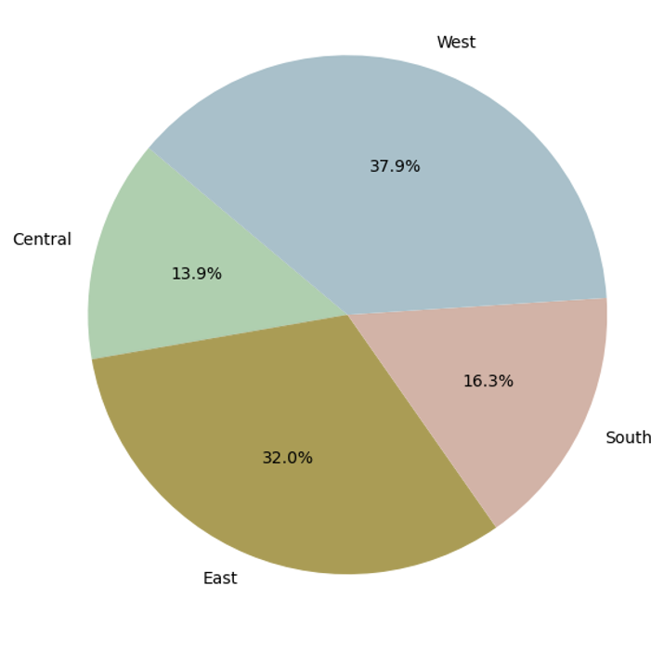
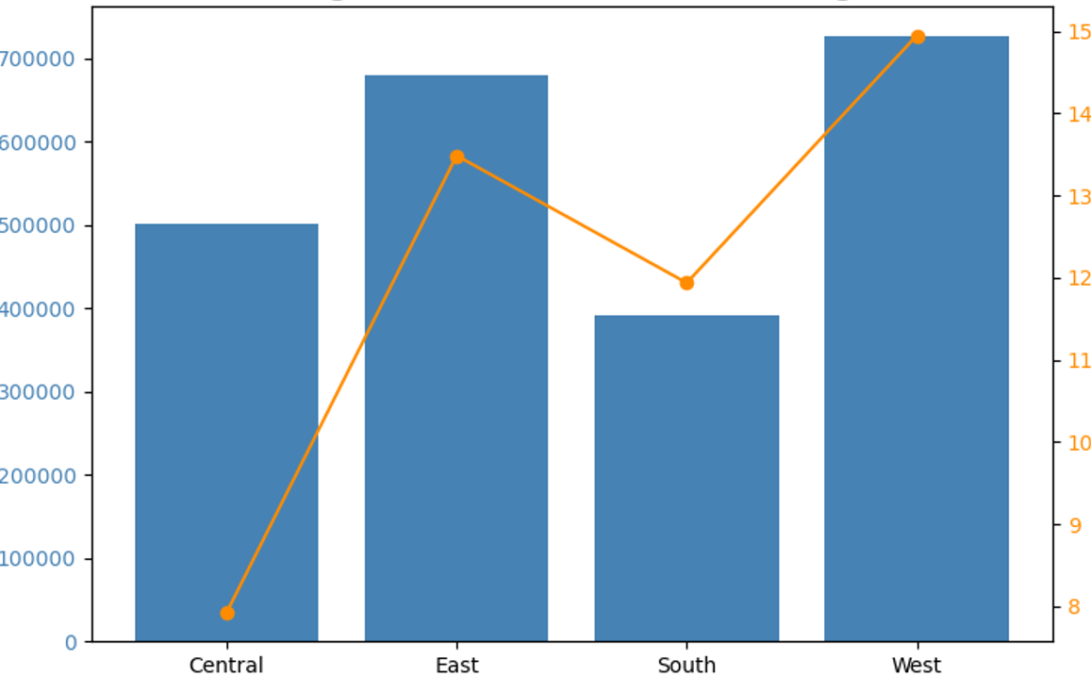
SALES BY REGION

Slide 18

CONCLUSION
THE ANALYSIS OF THE SUPERSTORE DATASET HIGHLIGHTS THAT ALTHOUGH AVERALL SALES ARE SHOWING GROWTH, PROFIT
MARGINS REMAINS INCONSISTENT DUE TO EXCESSIVE DISCOUNTS AND CERTAIN LOW-PERFORMING PRODUCTS CATEGORIES
TECHNILOGY AND OFFICE SUPPLIES EMERGE AS STRONG CONTRIBUTORS TO BOTH SALES AND PROFITS, WHILE FURNITURE
GENERATES HIGH SALES BUT STRUGGLES WITH PROTIABILITY.
REGION-WISE, THE WEST LEADS IN PERFORMANCE, WHEREAS THE SOUTH LAGS BEHIND IN BOTH SALES AND PROFIT. THE
FINDINGS SUGGEST THAT OPTIMIZING DISCOUNTS STRATEGIES, FOCUSING ON HIGH-MARGIN SUB-CATEGORIES , AND
IMPROVING PERFOMANCE IN WEEKAR REGIONS CAN SIGNIFICANTS BOOST OVERALL PROTIABILITY AND BUSSINESS GROWTH

